Slide 1

Project Evaluation Semester II
Group members
Shardul Kulkarni - B151094272
Abhikt mehare - B151094282
Sagar borle - B151094222
Group NO - 9
Under the Guidance of
Prof. P. P. Shevatekar
Department of Computer Engineering
Dr D. Y. Patil Institute of Engineering ,Management and Research,
Akurdi,Pune-44

Slide 2
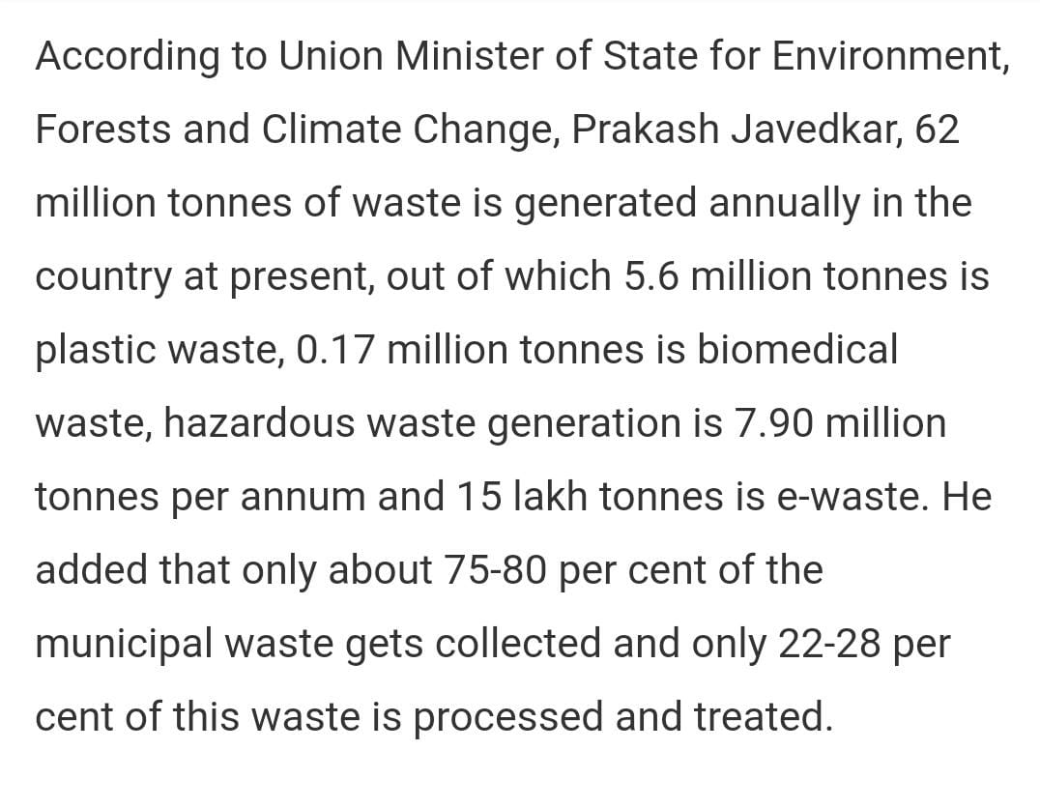
System For Waste Management: Swachh Bharat Mission
Waste Management Is All The Activities And Actions Required To Manage Waste From Its Inception To Its Final Disposal.
Proper Waste Management can reduce global warming.
Many metropolitan cities are facing the issues for deposition of waste produced from day to day activities.
So, the smart Artificial Intelligence based solution needs to be implemented to handle this issues.
.

Slide 3
Literature Survey
Sr.No | Author | Title of Paper And Year | Methodologies | Disadvantages
1. | Cenk Bircanoğlu, Meltem Atay, Fuat Beşer, Özgün Genç, Merve Ayyüce Kizrak | RecycleNet: Intelligent Waste Sorting Using Deep Neural Networks (2018) | Tried several different deep CNN architectures and applied different optimization methodologies on neural networks. To enhance the prediction performance of the models, altered the connection patterns of the skip connections inside dense blocks. Found Recyclenet as Optimized deep CNN. | The networks used in this paper are slightly slower in prediction which may impact the overall system.
2. | Gary White, Christian Cabrera, Andrei Palade, Fan Li, Siobh´an Clarke | WasteNet: Waste Classification at the Edge for Smart Bins (2020) | Prepared a waste classification CNN based model called WasteNet which can be deployed at low power device using transfer learning and data augmentation. | There are some confused classification in this model which leads to mislabelled Classification of recyclable waste.
3. | Muhannad Al-Jabi, Mohammad Diab | IoT-Enabled Citizen Attractive Waste Management System (2017) | It involves the waste management process by using IoT unit on each trash bin equipped with an RFID reader, weight sensor and ultrasonic sensor to evaluate the citizen interaction with the system and give them points according to that interaction. Moreover, the system provides a control mechanism for the waste collection trucks, such that it has a control that verifies the location for dumping and evacuation processes before it permits any process to start. | Algorithms used do not consider the filling rate of each bin, the truck location and the shortest path in order the threshold for each bin as well to optimize the bin dumping process.

Slide 4
Sr.No | Author | Title of Paper And Year | Methodologies | Disadvantages
4. | Dimitris Ziouzios, Dimitris Tsiktsiris, Nikolaos Baras and Minas Dasygenis | A Distributed Architecture for Smart Recycling Using Machine Learning (2020) | Paper has cloud based classification algorithm for automated machines in recycling factories using machine learning using which outputs 96.57 accuracy on MobileNet model improved by data augmentation and hyper-parameter tuning. | Did not evaluate performance of system on federated learning techniques.
5. | Fayez Alqahtani,Zafer Al-Makhadmeh, Amr Tolba, Wael Said3 | Internet of things-based urban waste management system for smart cities using a Cuckoo Search Algorithm (2020) | This paper analyzed a CLSTRNN-based approach to urban smart waste management. TrashNet dataset properties was extracted through the use of robust speeded-up descriptors. From the derived value, the features were trained and stored with their respective class labels in the database using tanh activation function Thus, the introduced system improved the overall waste management system on the basis of bin priority with minimum processing time (15 min), max accuracy (98.4%), and minimum error (0.16). | Applying Metaheuristic feature selection along with the feature training process should have improved the performance.
6. | Chutimet Srinilta, Sivakorn Kanharattanachai | Municipal Solid Waste Segregation with CNN (2019) | This paper explored performance of CNN-based waste-type classifiers (VGG-16, ResNet-50, MobileNet V2 and DenseNet-121) in classifying waste types of 9,200 municipal solid waste images.Derived classifiers outperformed others.ResNet-50 classifiers performed equally well in classifying waste items and waste types. | The training dataset is very small which suggest that model may not be reliable.

Slide 5
Sr.No | Author | Title of Paper And Year | Methodologies | Disadvantages
7. | Zhuang Kang , Jie Yang , Guilan Li and Zeyi Zhang | An Automatic Garbage Classification System Based on Deep Learning (2020) | This paper proposes an improved algorithm based on ResNet-34 and three tailor-made modifications, including the multi feature fusion, the feature reuse of residual unit, and optimization of activation function. An automatic garbage classification system is integrated with the proposed algorithm and necessary hardware, and the system is effective with the classification accuracy as high as 0.99 and stable with the classification cycle as quick as 0.95 seconds on average. | The classification of small target is not well and can be improved in future and the classification criteria can be further extended, such as kitchen waste.
8. | Sachin Hulyalkar, Rajas Deshpande, Karan Makode, and Siddhant Kajale | Implementation of Smartbin Using Convolutional Neural Networks (2018) | This paper is divided primarily into 3 modules: - The classifier module. The Raspberry Pi module. The website module The classifier module is a CNN based prediction module which is fed with an images captured by the raspberry pi module for prediction of 4 classes of waste. The website module provides the graphical monthly statistical report about the percentage of waste segregated by each bin. | Image segmentation can be used to separate multiple waste materials in the same image. Occlusion Detection can be done in order to find the hidden objects Sensors can be used in the trash cans in order to keep a check on the waste levels.

Slide 6
Sr.No | Author | Title of Paper And Year | Methodologies | Disadvantages
9. | Krishna C. Rao, Binu Parthan and Kamalesh Doshi | Power from municipal solid waste at Pune Municipal Corporation (2016) | It demonstrates power generation from organic fraction of MSW in Pune Municipal Corporation(PMC) through generation of biogas and also the MAILHEM-PMC BIOGAS PLANT BUSINESS MODEL CANVAS.PMC biogas to electricity value chain provides the insights regarding the eco friendly electricity generation and its consumption by PMC. | Lack of public awareness and active commitment and participation of citizens in local collection schemes.
10. | Nurul Awanis Muhamad Faudzi, and Zarul Fitri Zaaba | Interactive and Usable Waste Management System: A concept by My Intelligent Bin (MIB) (2018) | The paper describes My Intelligent Bin (MIB),a new waste management system application that give benefits to both citizen and waste management company as the application can show garbage collection schedule, check garbage status collected or not, report problems and give feedback directly to the waste management company. For waste management company they able to generate report based on the report and used it as their reference to improve their service. QR Code scanning is used as a method for the garbage collection process so that waste management company able to track the waste management process in real time. | It can only work with the usage of Internet and it only suitable for small residential area (i.e. registered with the company).Also load balancing of user pooling might affect the app.

Slide 7
Problems
According to Dr. Kumar, a senior scientist at CSIR-National Environmental Engineering Research Institute (CSIR-NEERI), INDIA, the major problems affecting solid waste management are unscientific treatment, improper collection of waste, and ethical problems.
This in turn leads to hazards like environmental degradation, water pollution, soil pollution, and air pollution.
According to 2019 survey, over 377 million urban people live in 7,935 towns and cities and generate 62 million tonnes of municipal solid waste per annum. Only 43 million tonnes (MT) of the waste is collected, 11.9 MT is treated and 31 MT is dumped in landfill sites.

Slide 8
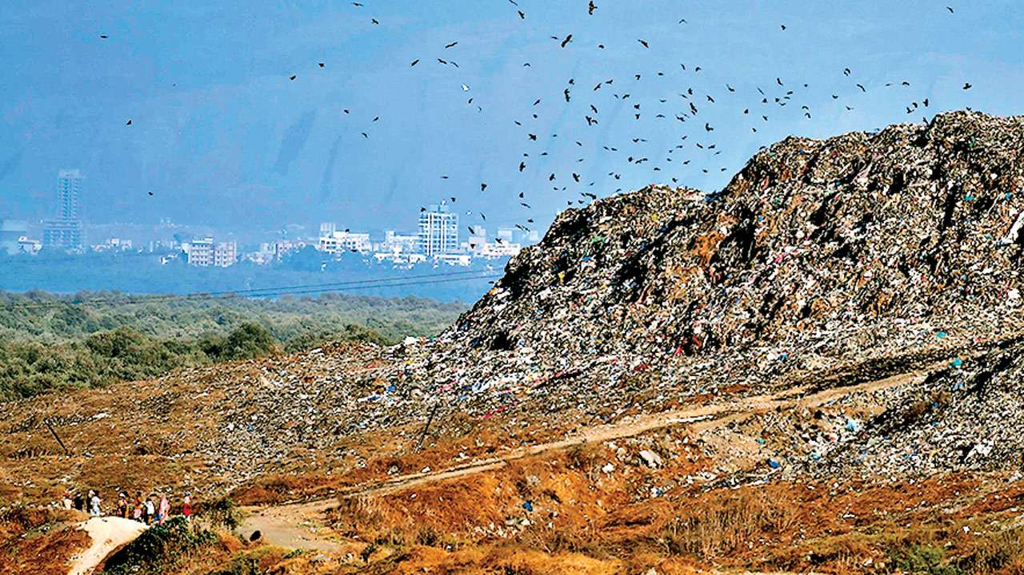
Deonar dumping ground of Mumbai is the largest dumping ground of India where waste has reached up to the height of 164 ft.
In 2019, BMC said, it will take more than 40 months to make the waste-to-energy plant at the site completely operational

Slide 9
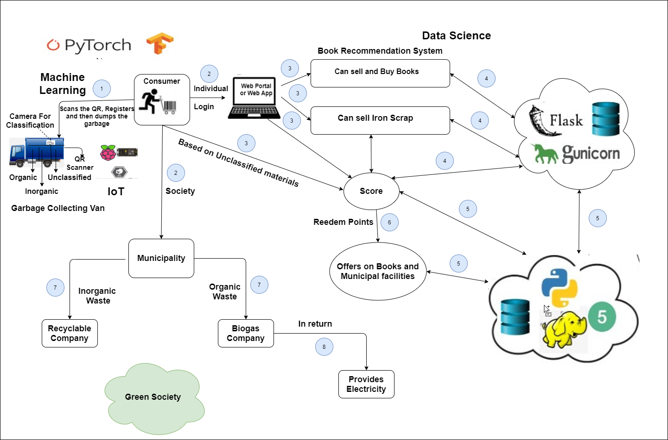
System Architecture

Slide 10
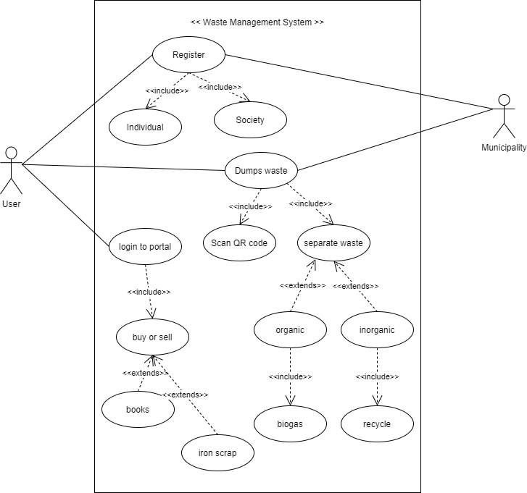
Use Case Diagram

Slide 11
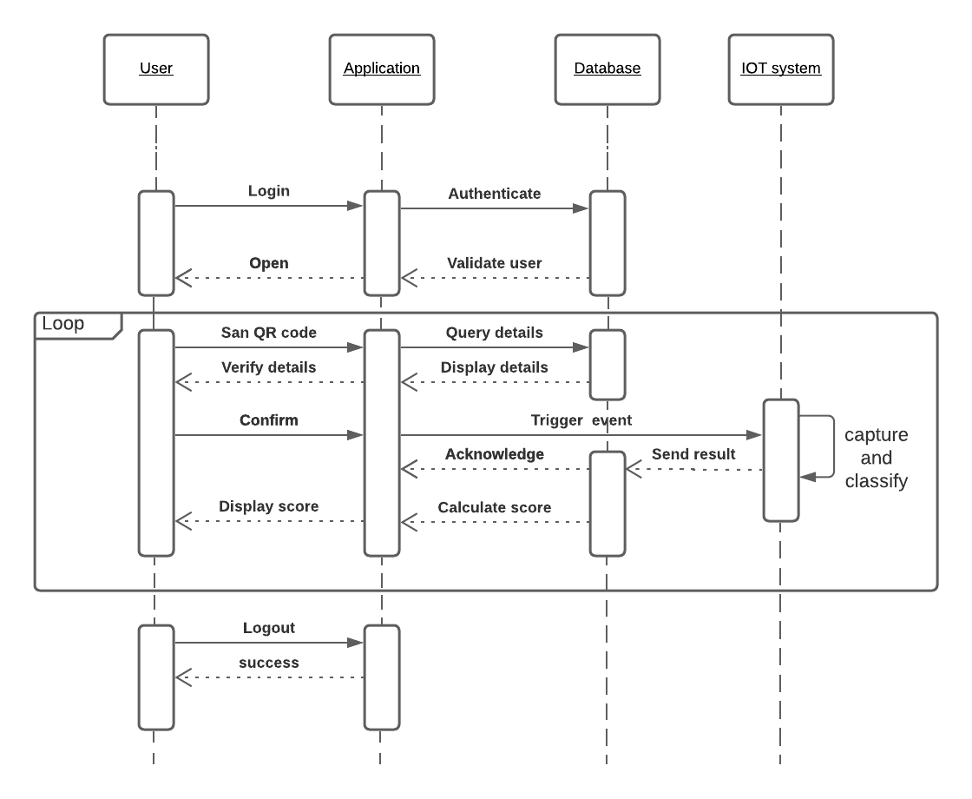
Sequence Diagram

Slide 12
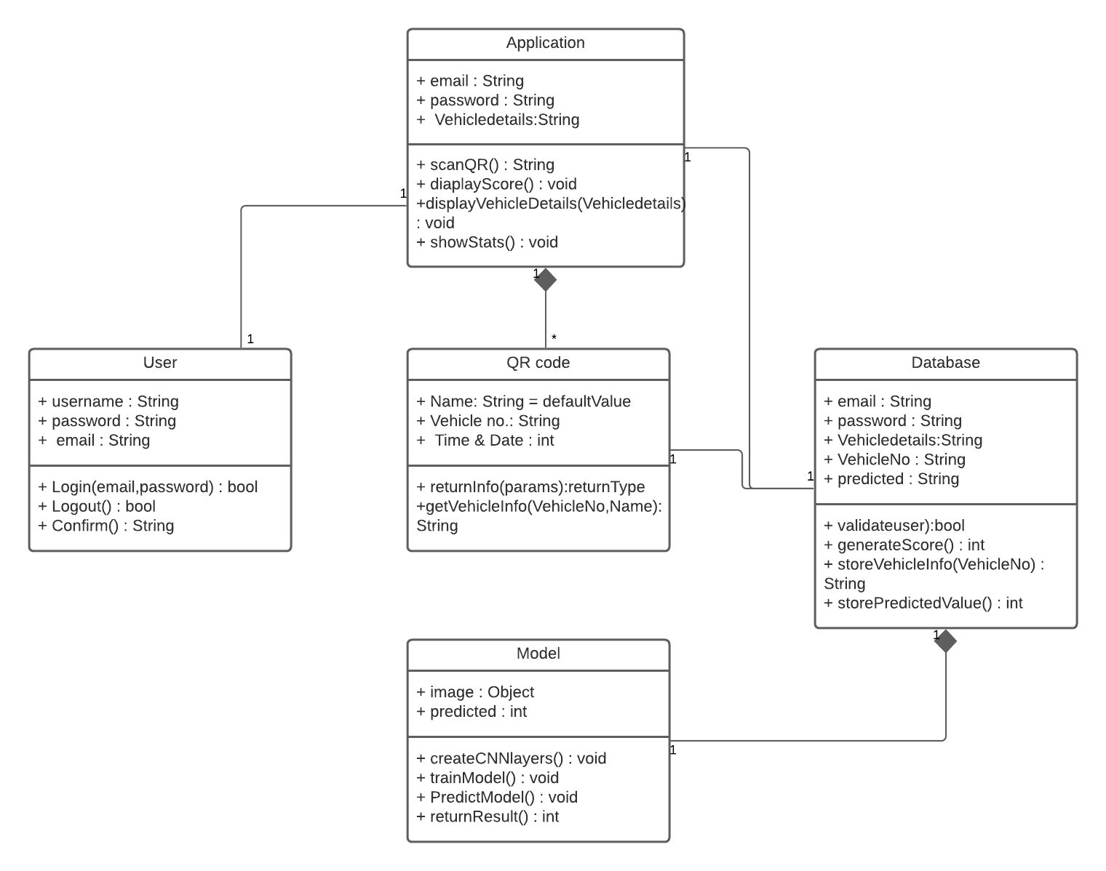
Class Diagram

Slide 13
Software Requirements
Jupyter Notebook
Tensorflow
Keras
SSH Along With Key Setup Between Pi And Server
Python3
Hardware Requirements
Raspberry Pi
Pi Camera
Servo Motor
IR Sensor

Slide 14
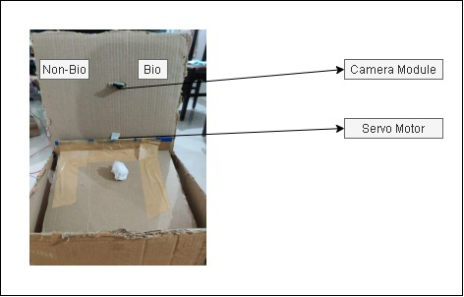
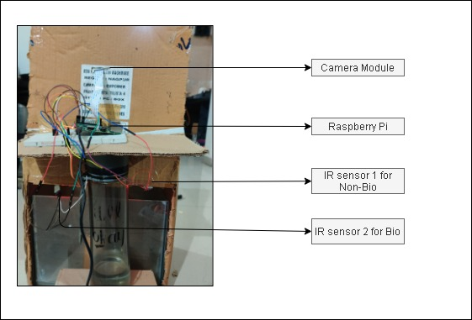
Prototype
Front-view of the prototype
Back-view of the prototype

Slide 15
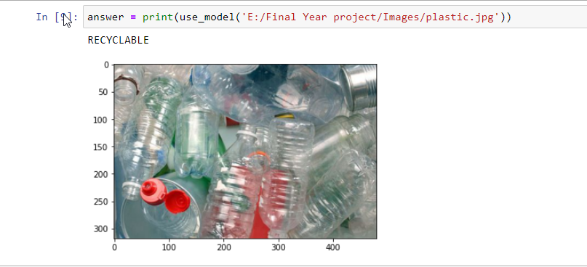
Deep Learning Model
Sequential Model:
We used a Deep Learning Keras model with 6 Convolutional Layers and 3 Dense Layers to achieve a 90% test accuracy. use_model function can be used to predict on new data.
Dataset:
We trained the model with 22564 images of which 12565 images were of organic items and 9999 images were of recyclable items.
For the test set we had 1401 images for organic items and 1112 images of recyclable items making a total of 2513 items.

Slide 16
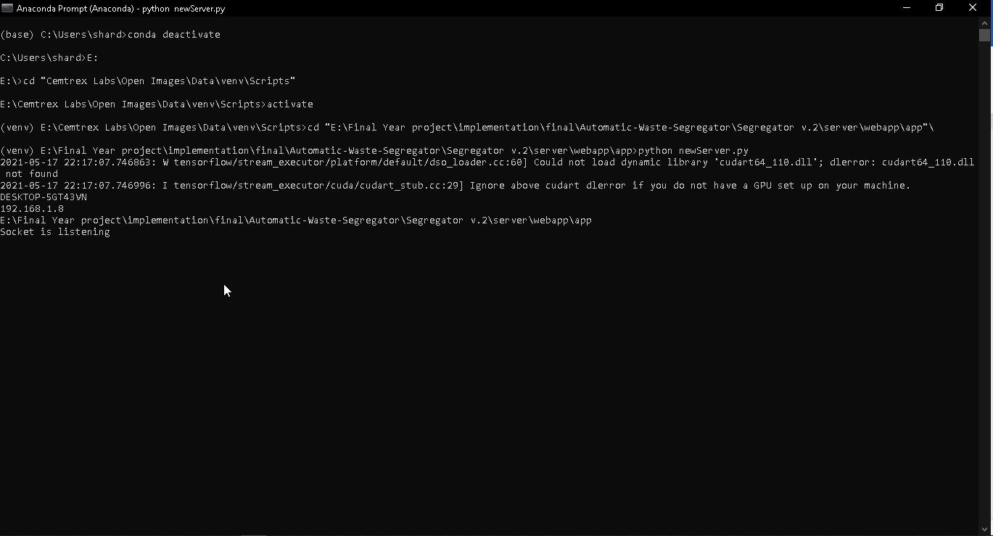
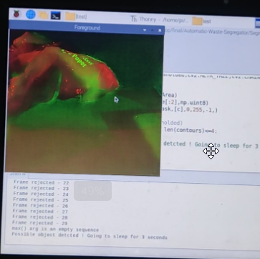
Screenshots
Starting the Server
Object is detected(Response from Client side)

Slide 17
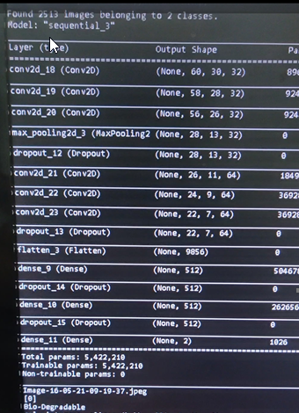
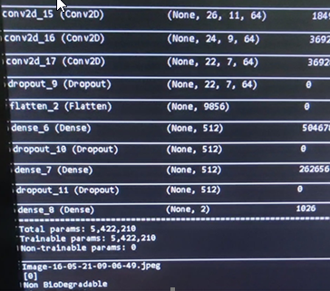
Results
Classifying the image into Bio-Degradable form depending on the image.
Classifying the image into Non-Bio-Degradable form depending on the image.

Slide 18
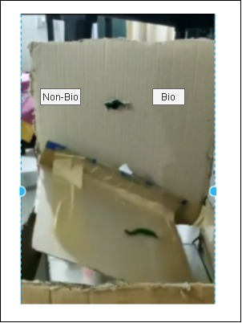
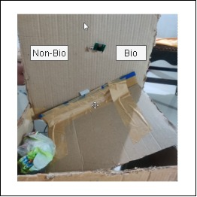
Results
Rotating the servo motor flap towards left side for Bio-degradable object
Rotating the servo motor flap towards right side for Non-Biodegradable object

Slide 19
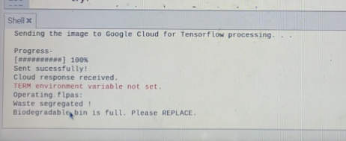
Results
Response from IR-sensor 2 (Biodegradable bin is full)
Starting the Server

Slide 20
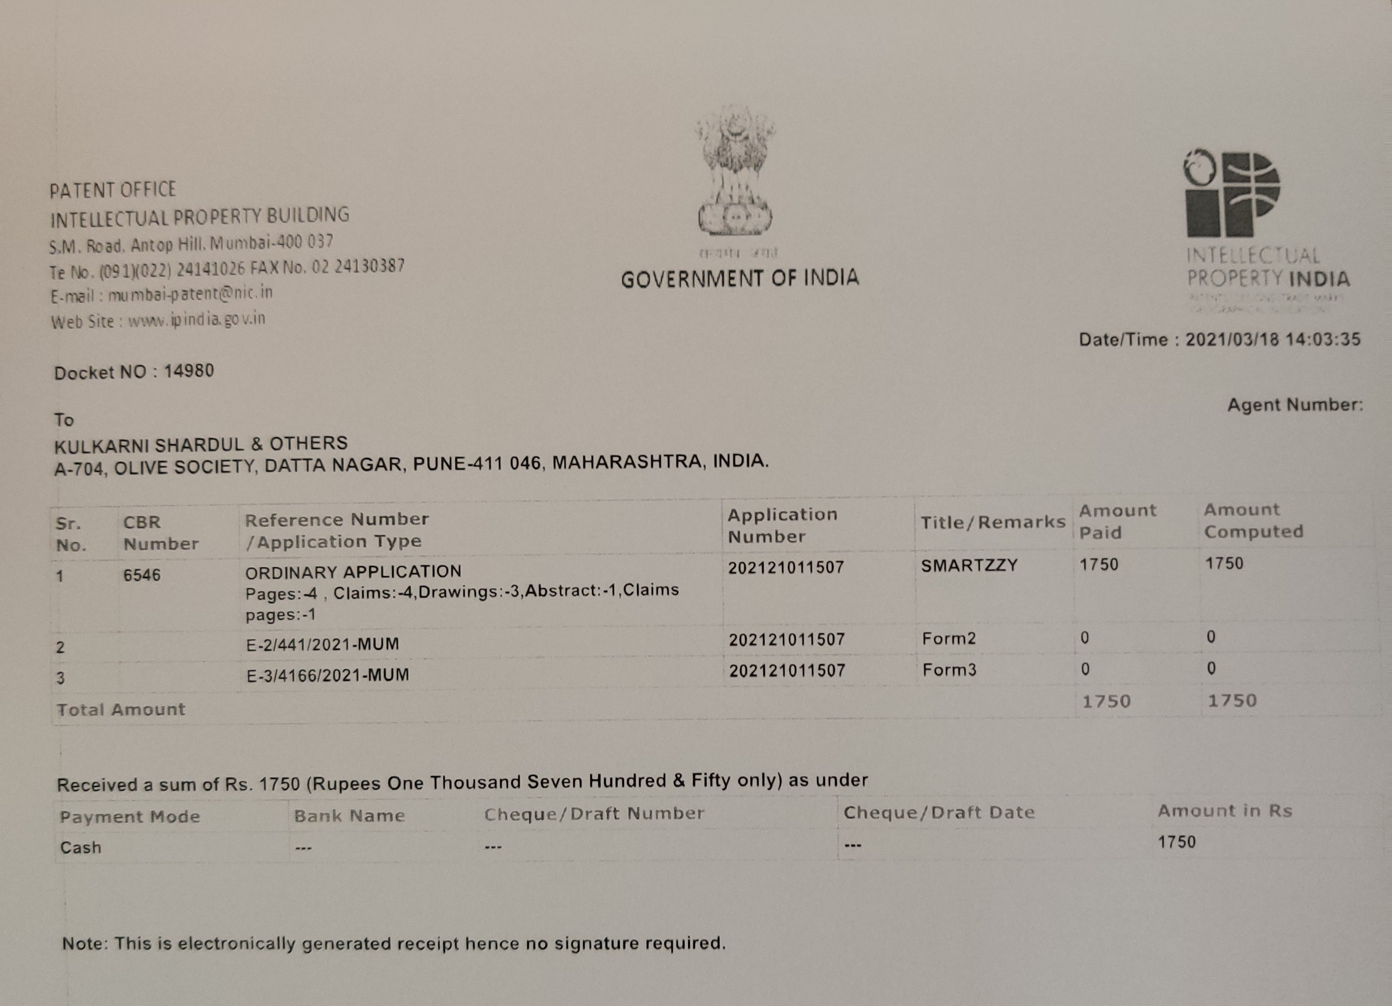
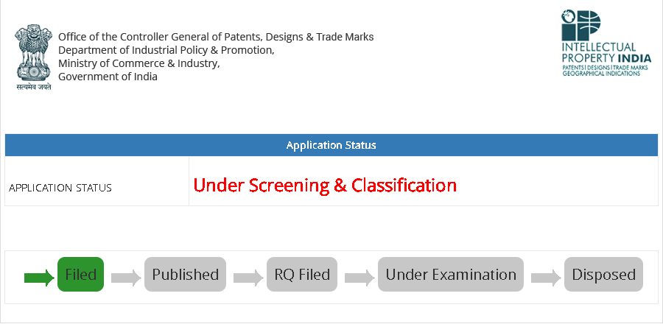
Patent
Patent Application Number: 202121011507

Slide 21
Conclusion
Till now, we have analyzed our problem statement, then completed literature survey by comparing 10 papers.
Noted down the requirements.
Built our own system architecture along with UML diagrams.
We have even built a deep learning model and achieved an accuracy of 90%.
We have filed a patent for this idea.
We have designed a prototype as well.

Slide 22
Future Enhancement
Will be implementing the software part of the system.
Can integrate a conveyor belt.
Enhance the accuracy of our model.
Increase the classes of waste classification.

Slide 23
References
Gary white, christian cabrera, andrei palade, fan li, siobh´an clarke school of computer science and statistics,trinity college dublin, dublin, ireland wastenet: waste classification at the edge for smart bins wed, 10 jun 2020
Muhannad al-jabi and mohammad diab, iot-enabled citizen attractive waste management system, IT-DREPS conference, amman, jordan dec 6-8, 2017
Fayez alqahtani, zafer al-makhadmeh, amr tolba and wael said, internet of things-based urban waste management system for smart cities using a cuckoo search algorithm, 6 may 2020 springer science+business media, LLC, part of springer nature 2020
Cenk bircanoglu, meltem atay, fuat beser , o¨zgu¨n genc and merve ayy¨uce kızrak , recyclenet: intelligent waste sorting using deep neural networks, 2018
Jose M. Gutierrez, michael jensen, morten henius and tahir riaz, smart waste collection system based on location intelligence, procedia computer science 61 ( 2015 )
Krishna C. Rao, binu parthan and kamalesh doshi , power from municipal solid waste at pune municipal corporation (pune, maharashtra, india) , 2017

Slide 24


